Slide 1
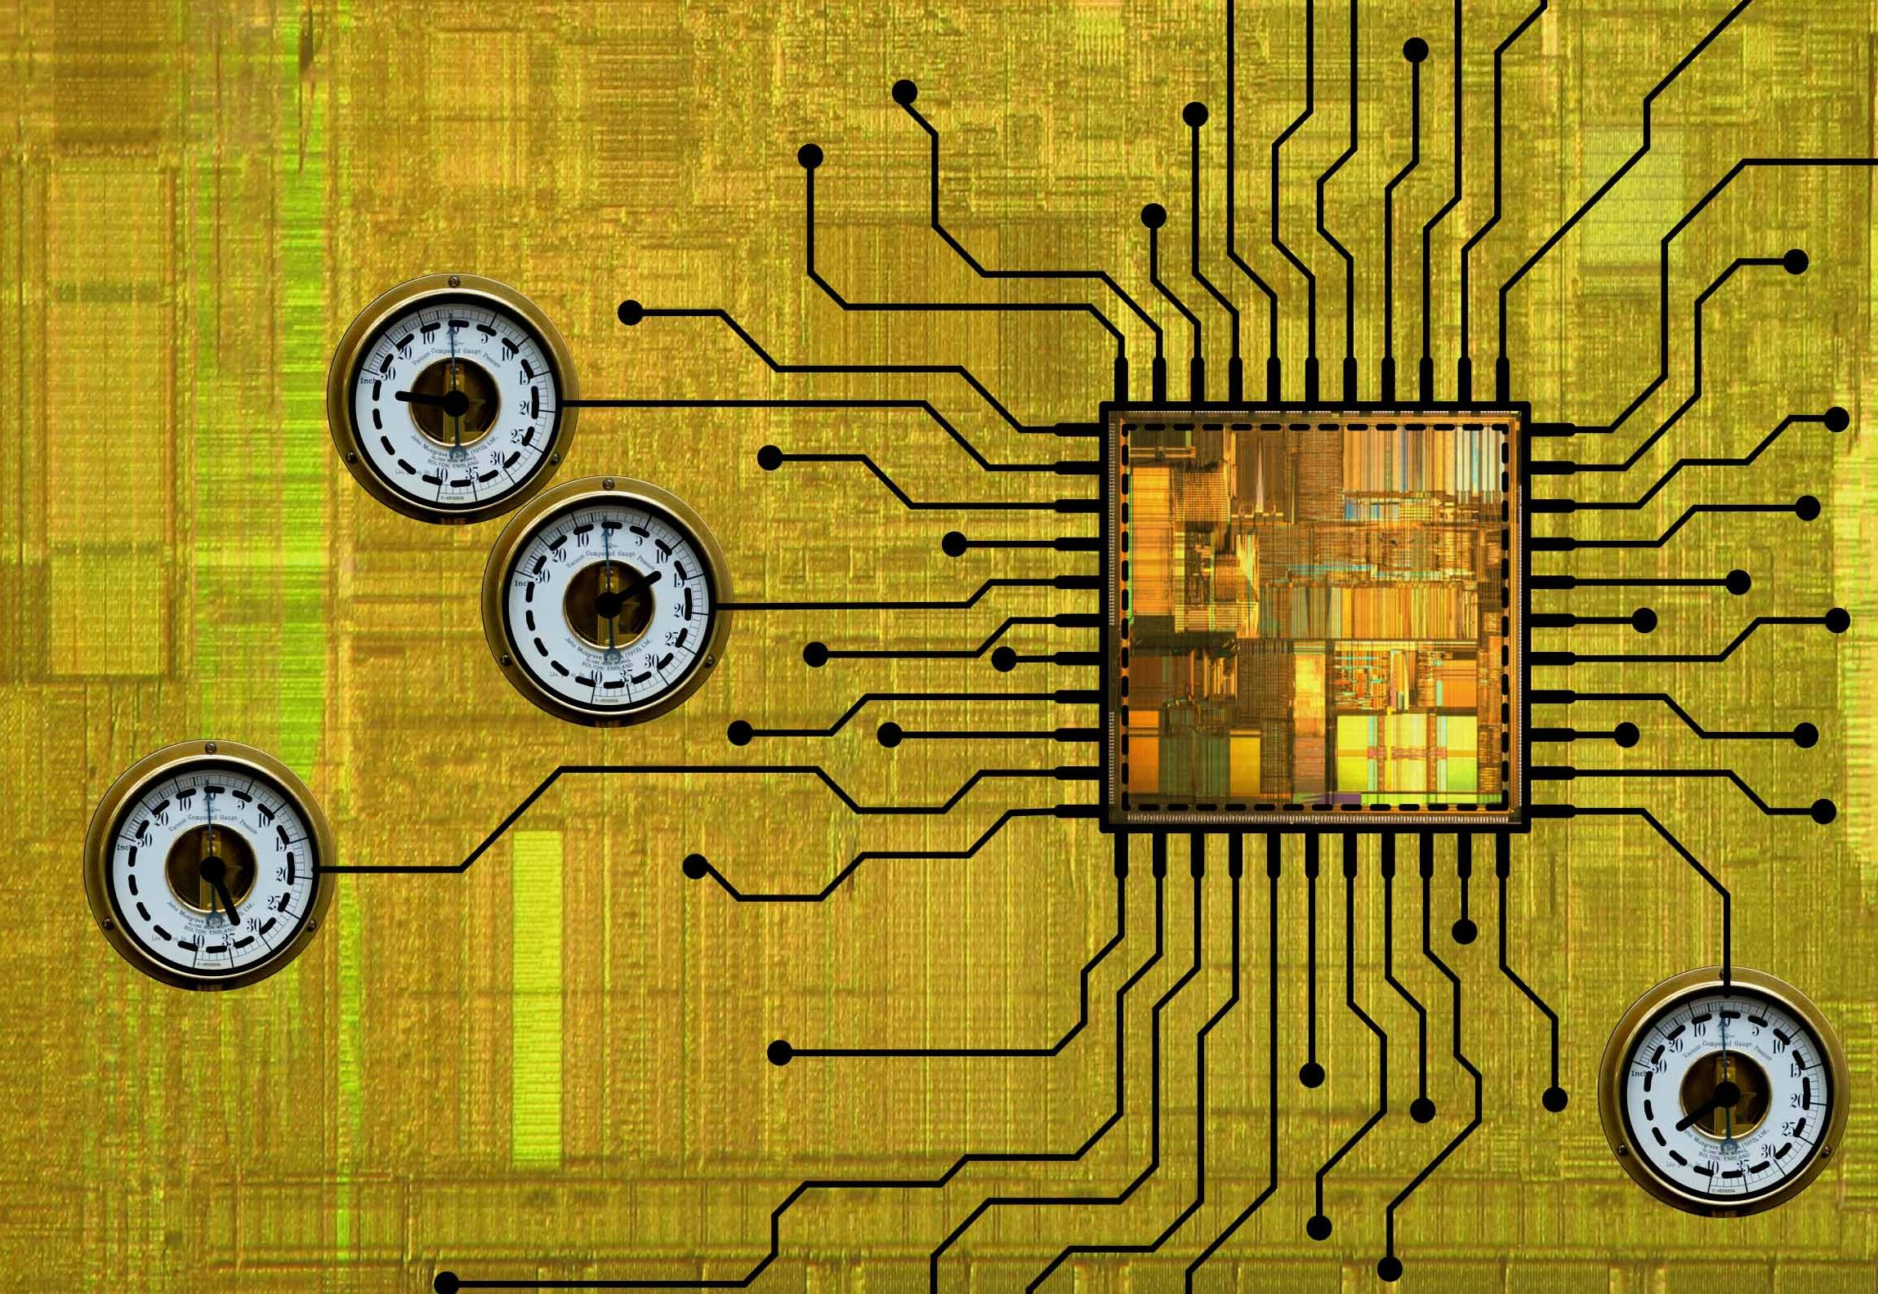
Concepts and Introduction to RNA Bioinformatics
Annalisa Marsico
Wintersemester 2014/15

Slide 2
Goals of this course - I
Soft skills
  Learn how to evaluate a research paper
  Learn what makes a paper good
  Learn how to get your paper published
  Learn how to give a scientific talk
  Learn to be critical / evaluate

Slide 3
Goals of this course - II
Hard skills
  Get an overview of the RNA bioinformatics field
  Learn how basic concepts / algorithms/ statistical methods are applied and extended in this field
  Learn how to ask the right biological question and choose the right computational methods ‚to solve it‘

Slide 4
Topics
1994
Algorithms / models for RNA structures
(dynamic programming, covariance models, EM algorithm)
..
..
..
..
..
..
ncRNAs -> applied statistical methods
(SVMs, Bayesian statistics, linear/logistic regression
models, HMMs)
~ 2000
..
..
..
..
..
..
Data-driven approaches, new technologies , more
biology and data analysis
2014

Slide 5
Course design
Today -> overview on the topics, assignment of papers
Student presentations
  Each student will choose a paper and will give a presentation
  Two presentations per term (30-40 minutes + 15 minutes questions)
  Discussion: questions, critical assessmnet

Slide 6
Presentation guidelines
Compression with minimal loss of information
Understand the context & data used
Identify the important question/motivation
Focus on the method
Summarize shortly the main findings
  Forget about unimportant details
Evaluate and think about possible future directions

Slide 7
Advices / Help
Read your paper twice before saying ‚I don‘t understand it‘
Read the supplementary material
Do not try to understand every detail but the general idea has to be clear
Main objective: lively interesting talk that promotes discussion
Come anytime to me with questions (write me 3-4 days before)
marsico@molgen.mpg.de
Tel: +49 30 8413 1843
where: MPI for Molecular Genetics, Ihnestrasse 63-73, Room 1.3.07
send me your presentation one week before your talk
Get feedback and give feedback (also to me ☺)

Slide 8
Practical information
Day | First talk | Second talk
October 15 | Introduction | Introduction
October 22 | questions | questions
October 29 | Rome | Rome
November 05
November 12
November 19
November 26
December 03
December 10
December 17
January 07 (‘15) | backup | backup

Slide 9
The „RNA revolution“
Not only intermediates between DNA and proteins, but informational molecules (enzymes)
The first primitive form of life? (Woese CR 1967)
Ability to function as molecular machines (e.g. tRNA, RNAs in splicesosome complex)
Ability to to function as regulators of gene expression (miRNA, sRNAs, piRNAs, lincRNA, eRNAs, ceRNAs..)
Different sizes and functions (e.g. miRNAs 22nt, lincRNAs > 200nt)
1.5 % of the human genome codes for protein, the rest is ‚junk‘
Since ten years junk has become really important -> transcribed in ncRNAs
More than 80% of human disease loci are within non-coding regions
A lot of tools developed to identify ncRNA genes
E.g. Rfam – database which collect RNA families and their potential functions

Slide 10
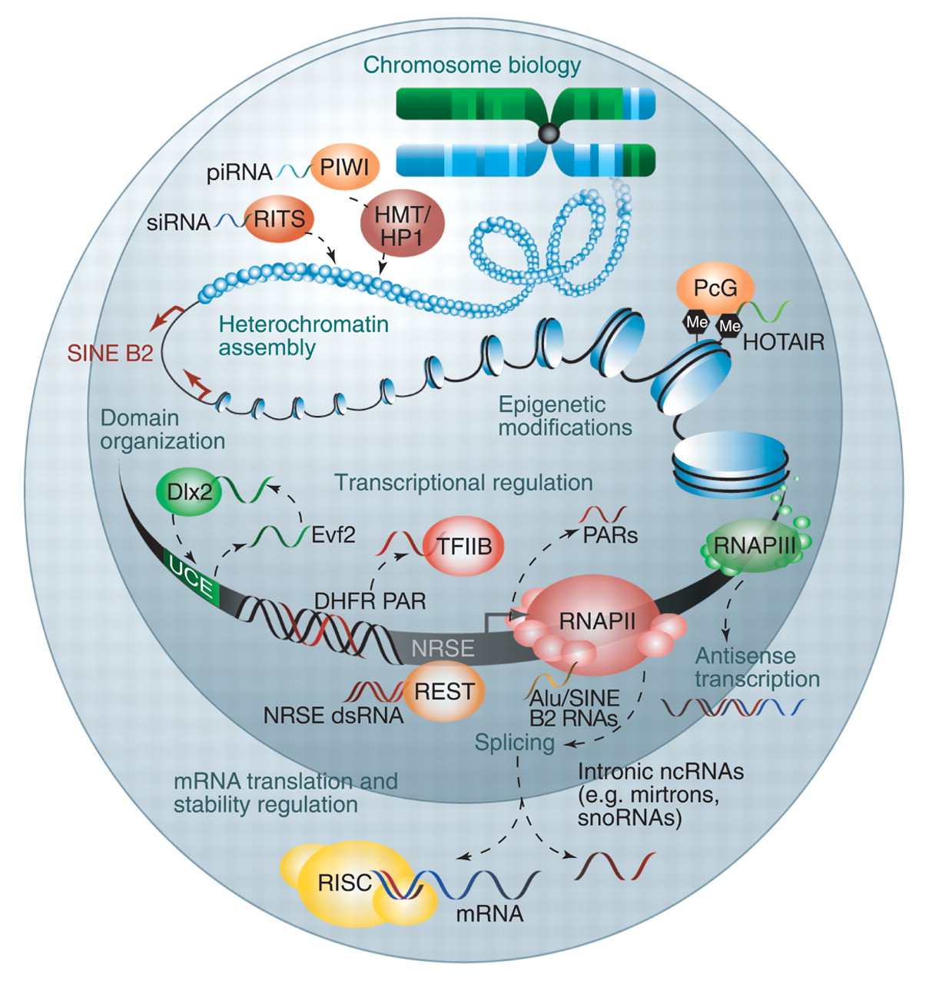
The Eukaryotic Genome as an RNA machine The ‘RNA world’
lincRNAs
Promoter-associated
RNAs
E(enhancer-like)RNAs
miRNAs
Amaral et al. Science 2008;319:1787-1789

Slide 11
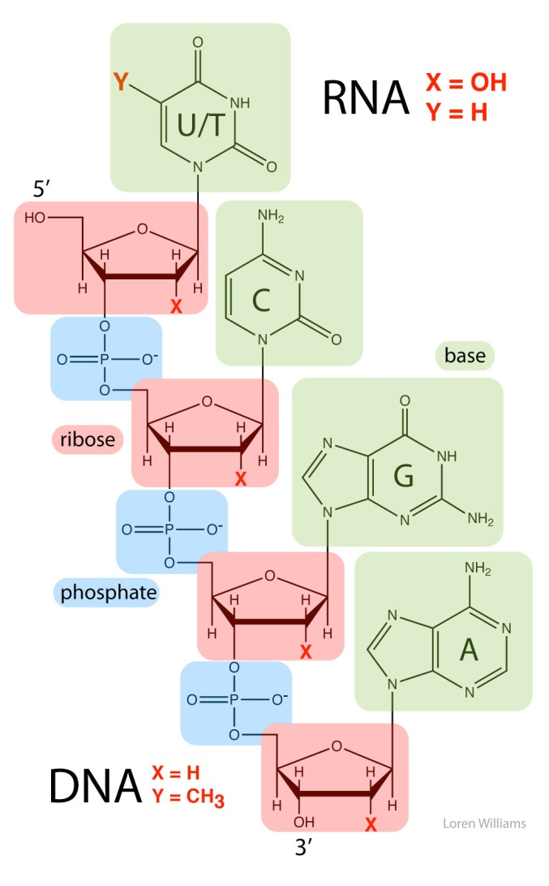
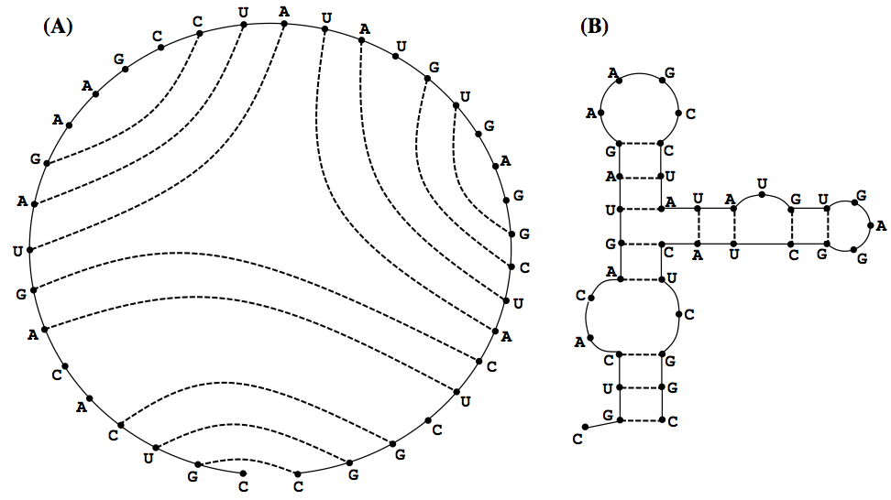
RNA backbone
Secondary structure: set of base pairs which can be mapped into a plane

Slide 12
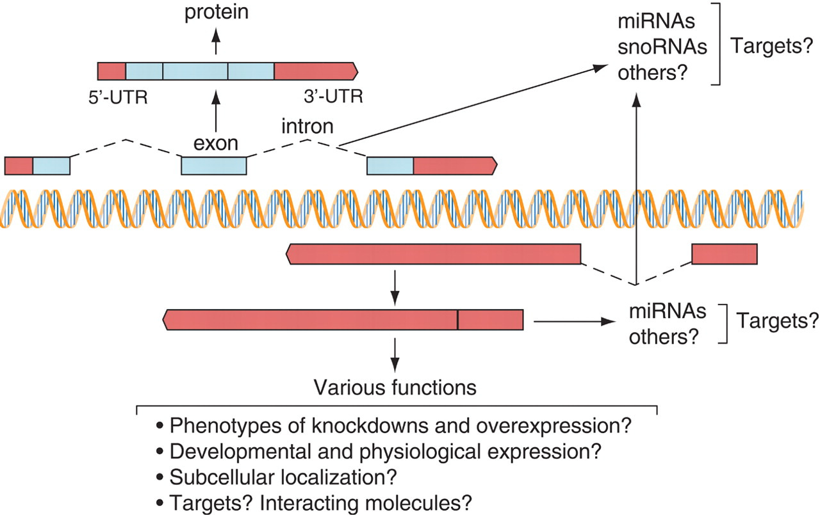
The complexity of transcription of protein-coding (blue) and noncoding (red) RNA sequences.
J S Mattick Science 2005;309:1527-1528

Slide 13
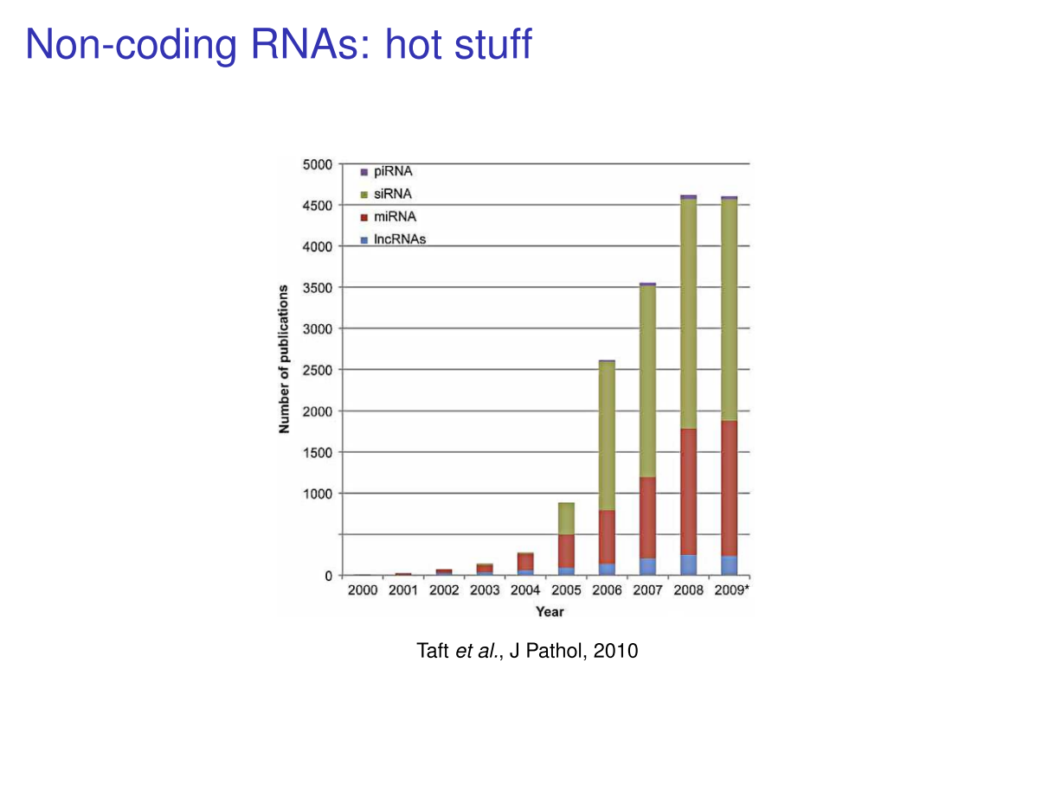
Non-coding RNAs: hot stuff
Nobel Prize in Physiology
or Medicine 2006

Slide 14
Research in RNA Bioinformatics past and perspectives -I
Initially focus on folding of single RNA molecules, but further improvements:
  Nussinov algorithm
  Zuker algorithm and partition function
  Fold many sequence togehter -> exploiting comparative information
  More complex models for finding RNA motifs
  Functional motifs /3D folding instead of only secondary structure
Searching for ncRNAs
miRNA identification
lncRNA (~13000 in the human genome) new challenge: poorly annotated, poorly conserved, strucures unkown
Focus RNA-RNA interactions and RNA-protein interactions
  miRNA target prediction
  lncRNA target prediction (indirect methods)
  RNA Binding Proteins (RBPs)

Slide 15
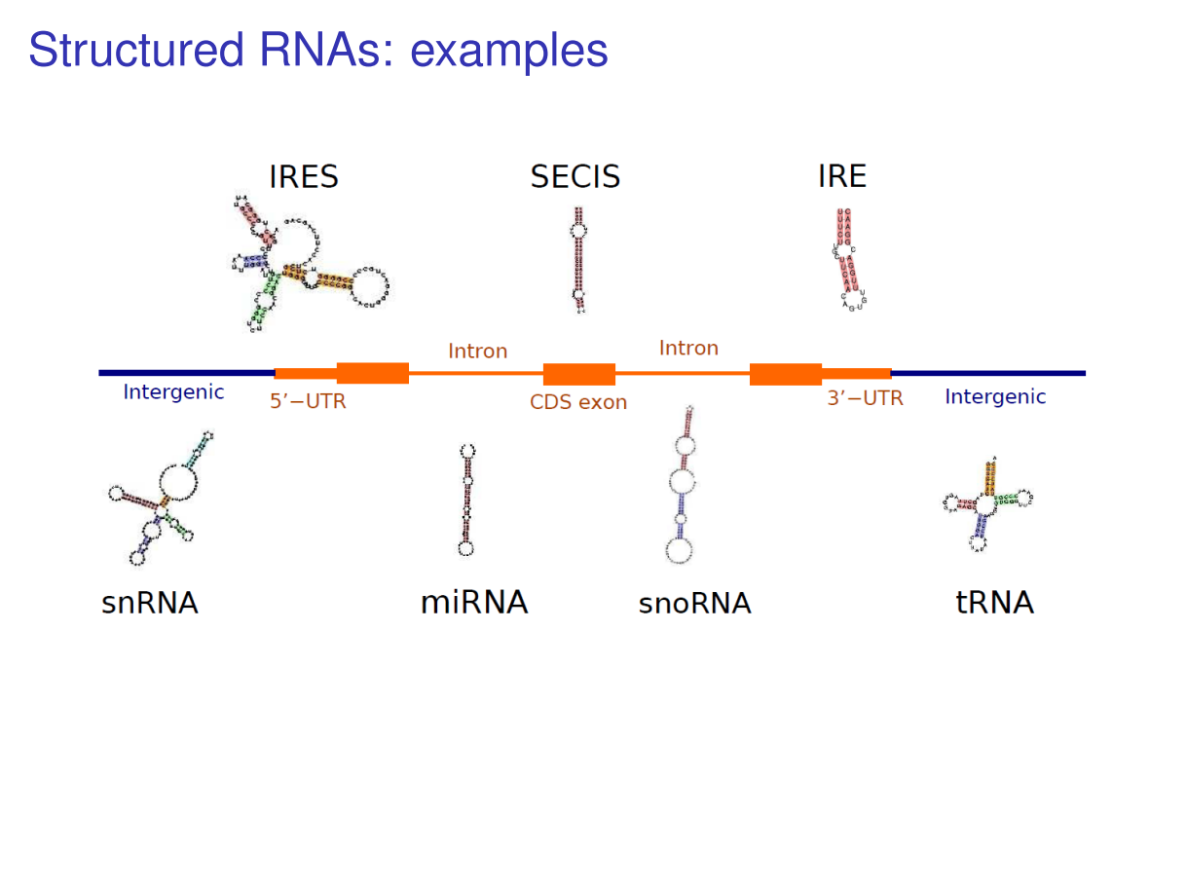
Slide from Dominic Rose
University of Freiburg

Slide 16
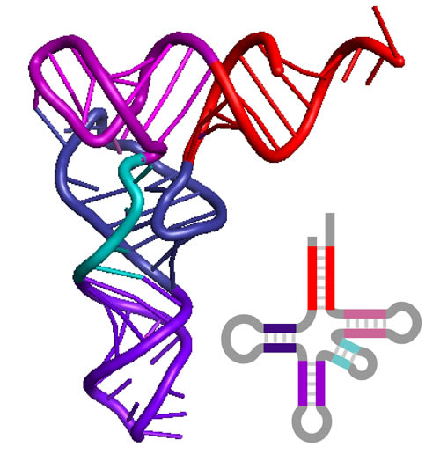
Structural conformations of RNAs
Primary structure: sequence of monomers ATGCCGTCAC..
Secondary structure: 2D-fold, defined by hydrogen bonds
Tertiary structure: 3D-fold
Quaternary structure: complex arrangement of
multiple folded molecules

Slide 17
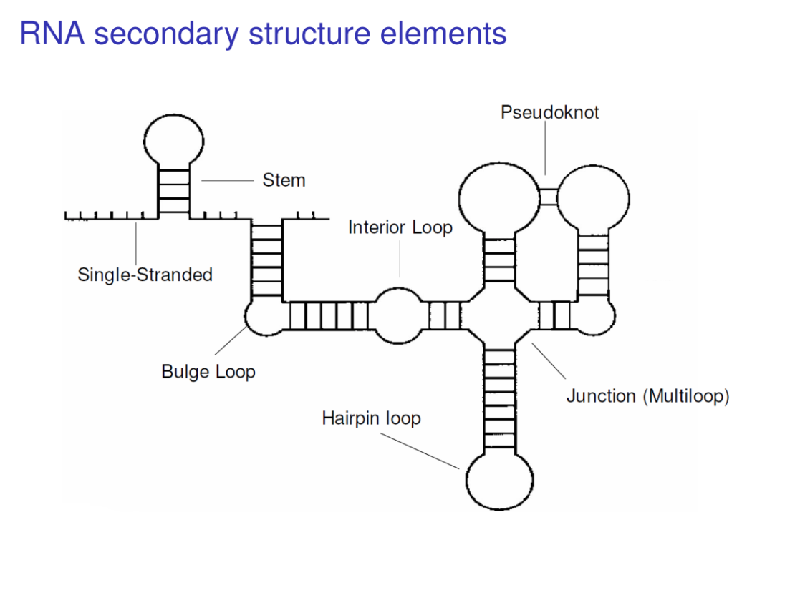
RNA folding prediction algorithms
Approximation: prediction of RNA secondary structure
RNAfold < trna.fa
>AF041468
GGGGGUAUAGCUCAGUUGGUAGAGCGCUGCCUUUGCACGGCAGAUGUCAGGGGUUCGAGUCCCCUUACCUCCA
(((((((..((((........)))).(((((.......))))).....(((((.......)))))))))))).
-31.10 kcal/mol

Slide 18
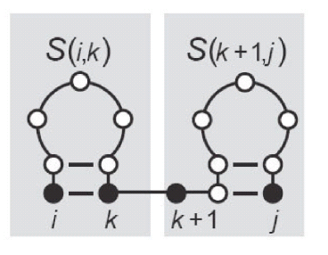
Nussinov Algorithm
Structure can be folded recursively -> dynamic programming
x1…….xN sequence of N nucleotides to be folded.
Compute maximum number of base pairs formed by subsequence x[i:j] assuming
we already computed for all short sequences x[m:n] i<m<l<j
Structure on x[i:j] can be computed in several ways:
1)
2)
3)
4)
bifurcation

Slide 19
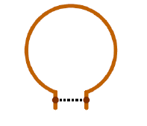


Nussinov drawbacks
It does not determine biological relevant structures since:
There are several possibilities to form base pairs, Nussinov finds only A-U and G-C
Stacking of base pairs not considered -> difference in structure and stability of helices
G—C G—C
C—G G—C
Size of intern loops not considered
unstable
stable
unstable
instable

Slide 20
RNA structure prediction: MFE-folding
More realisistic is to consider thermodynamics and statistical mechanis
Stability of an RNA structure coincides with thermodynamics stability
Quantified as the amount of free energyreleased/used by forming base pairs ∆G. The more negative ∆G the more stable is the structure
Can be measured for loops, stacks, and other motifs - > depends on the local surrounding
Complete free energy is the summation
Find the structure with lowest total free energy

Slide 21
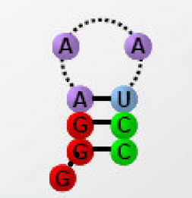
Sequence-dependent free energy
Nearest Neighbour Model -> rules that account for sequence dependency
Energy is influenced by previous base pair (not by base pairs further down)
Total energy = sum over stability of different motifs
Energies estimated experimentally from small synthetic RNAs
Example values: GC GC GC GC
AU GC CG UA
-2.3 -2.9 -3.4 -2.1

Slide 22
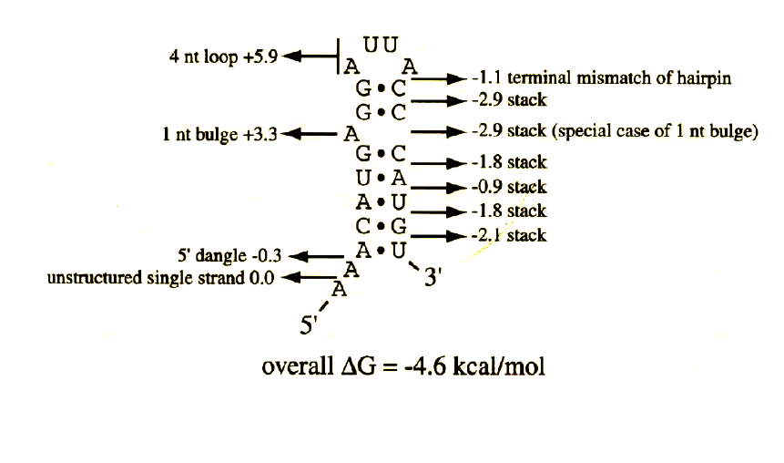
Nearest neighbour parameters
There are estimations of ∆G for different RNA structure motifs, e.g. canonical pairs, hairpin loops, buldges, internal mismatches, multi-loops..
How are they determined?
  Experimentally: optical melting experiments for different sequences
  Sequence dependency important
  Rules are mostly empirical - > implemented in dynamic programming algorithms (how?)

Slide 23
RNA structure prediction: MFE-folding
RNA moleculaes exist in a distribution of structures rather than a single conformation
„Most likely“ conformation: minimum free energy (MFE) structure
Energy contribution of different loop types have been measured
Based on loop decomposition , the total energy E of a structure S can be computed as the sum over the energy contributions of each constituent loop l:

Slide 24
Research in RNA Bioinformatics past and perspectives -I
Initially focus on folding of single RNA molecules, but further improvements:
  Nussinov algorithm
  Zuker algorithm and partition function
  Fold many sequence togehter -> exploiting comparative information
  More complex models for finding RNA motifs
  Functional motifs /3D folding instead of only secondary structure
Searching for ncRNAs
miRNA identification
lncRNA (~13000 in the human genome) new challenge: poorly annotated, poorly conserved, strucures unkown
Focus RNA-RNA interactions and RNA-protein interactions
  miRNA target prediction
  lncRNA target prediction (indirect methods)
  RNA Binding Proteins (RBPs)

Slide 25
RNA fold predictions based on multiple alignment
Information from multiple sequence alignment (MSA) can help to predict the probability of positions i,j to be base-paired -> exploit compensatory substitution
G A C U U C G G U C
Observed base pair a-b
Mutual Information
Between column i and j
Fraction of base b in column j
Fraction of base a in column i

Slide 26
RNA fold predictions based on multiple alignment
Important: mutual information does not capture conserved base pairs
Conservation – no additional information
non-compensatory mutations (GC - GU) – do not support stem
Compensatory mutations – support stem.
Information from multiple sequence alignment (MSA) can help to predict the
probability of positions i,j to be base-paired -> modification of dynamic programming
algorithm by adding M_{ij} term to the energy model

Slide 27
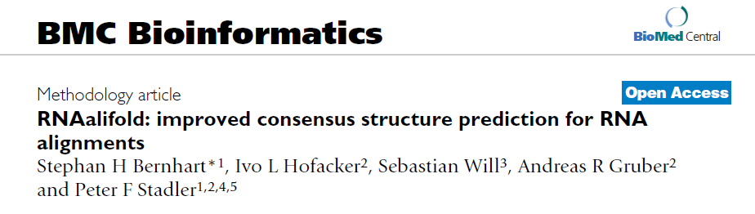
PMID: 19014431

Slide 28
Research in RNA Bioinformatics past and perspectives -I
Initially focus on folding of single RNA molecules, but further improvements:
  Nussinov algorithm
  Zuker algorithm and partition function
  Fold many sequence togehter -> exploiting comparative information
  More complex models for finding RNA motifs
  Functional motifs /3D folding instead of only secondary structure
Searching for ncRNAs
miRNA identification
lncRNA (~13000 in the human genome) new challenge: poorly annotated, poorly conserved, strucures unkown
Focus RNA-RNA interactions and RNA-protein interactions
  miRNA target prediction
  lncRNA target prediction (indirect methods)
  RNA Binding Proteins (RBPs)

Slide 29
PMID: 8029015
PMID: 16357030

Slide 30
Research in RNA Bioinformatics past and perspectives -I
Initially focus on folding of single RNA molecules, but further improvements:
  Nussinov algorithm
  Zuker algorithm and partition function
  Fold many sequence togehter -> exploiting comparative information
  More complex models for finding RNA motifs
  Functional motifs /3D folding instead of only secondary structure
miRNA identification – valid methods
lncRNA (~13000 in the human genome) new challenge: poorly annotated, poorly conserved, strucures unkown
Focus RNA-RNA interactions and RNA-protein interactions
  miRNA target prediction
  lncRNA target prediction (indirect methods)
  RNA Binding Proteins (RBPs)

Slide 31
PMID: 22495308
PMID: 21552257

Slide 32
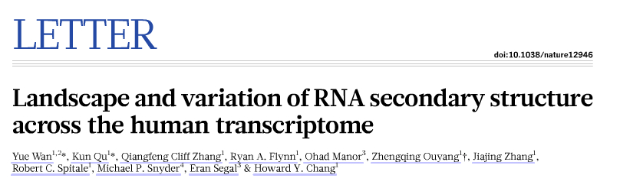
Next-generation sequencing enables measuring RNA secondary structure genome-wide
PMID: 24476892

Slide 33
Research in RNA Bioinformatics past and perspectives -I
Initially focus on folding of single RNA molecules, but further improvements:
  Nussinov algorithm
  Zuker algorithm and partition function
  Fold many sequence togehter -> exploiting comparative information
  More complex models for finding RNA motifs
  Functional motifs /3D folding instead of only secondary structure
Searching for ncRNAs
miRNA identification – valid methods
lncRNA (~13000 in the human genome) new challenge: poorly annotated, poorly conserved, strucures unkown
Focus RNA-RNA interactions and RNA-protein interactions
  miRNA target prediction
  lncRNA target prediction (indirect methods)
  RNA Binding Proteins (RBPs)

Slide 34
From structure prediction to ncRNA identification and function
Methods evolved from single sequence folding to genomic screen for RNA structures!
Focus not anymore prediction of RNA structure, but structure prediction as hallmark of ncRNAs or regulatory motifs in mRNAs.
Searching for ncRNAs employs usually two strategies:
Homology search:
  Start from alignment (use secondary structure information) and exploit it to find matches in the genome
  Good to search for RNAs in a certain family
  Depends on the depth of phylogeny
De novo search:
  Search for folding of a certain RNA whose structure features (e.g. energy) differ from background / random sequences

Slide 35
Research in RNA Bioinformatics past and perspectives -I
Initially focus on folding of single RNA molecules, but further improvements:
  Nussinov algorithm
  Zuker algorithm and partition function
  Fold many sequence togehter -> exploiting comparative information
  More complex models for finding RNA motifs
  Functional motifs /3D folding instead of only secondary structure
Searching for ncRNAs
miRNA identification – valid methods
lncRNA (~13000 in the human genome) new challenge: poorly annotated, poorly conserved, strucures unkown
Focus RNA-RNA interactions and RNA-protein interactions
  miRNA target prediction
  lncRNA target prediction (indirect methods)
  RNA Binding Proteins (RBPs)

Slide 36
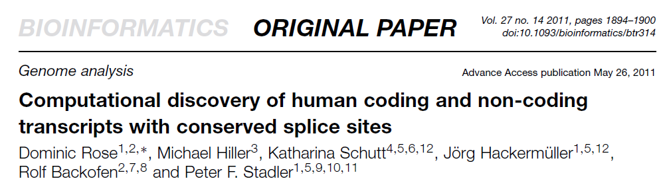
PMID: 15665081
PMID: 21622663

Slide 37
Research in RNA Bioinformatics past and perspectives -I
Initially focus on folding of single RNA molecules, but further improvements:
  Nussinov algorithm
  Zuker algorithm and partition function
  Fold many sequence togehter -> exploiting comparative information
  More complex models for finding RNA motifs
  Functional motifs /3D folding instead of only secondary structure
Searching for ncRNAs
miRNA identification – valid methods
lncRNA (~13000 in the human genome) new challenge: poorly annotated, poorly conserved, strucures unkown
Focus RNA-RNA interactions and RNA-protein interactions
  miRNA target prediction
  lncRNA target prediction (indirect methods)
  RNA Binding Proteins (RBPs)

Slide 38
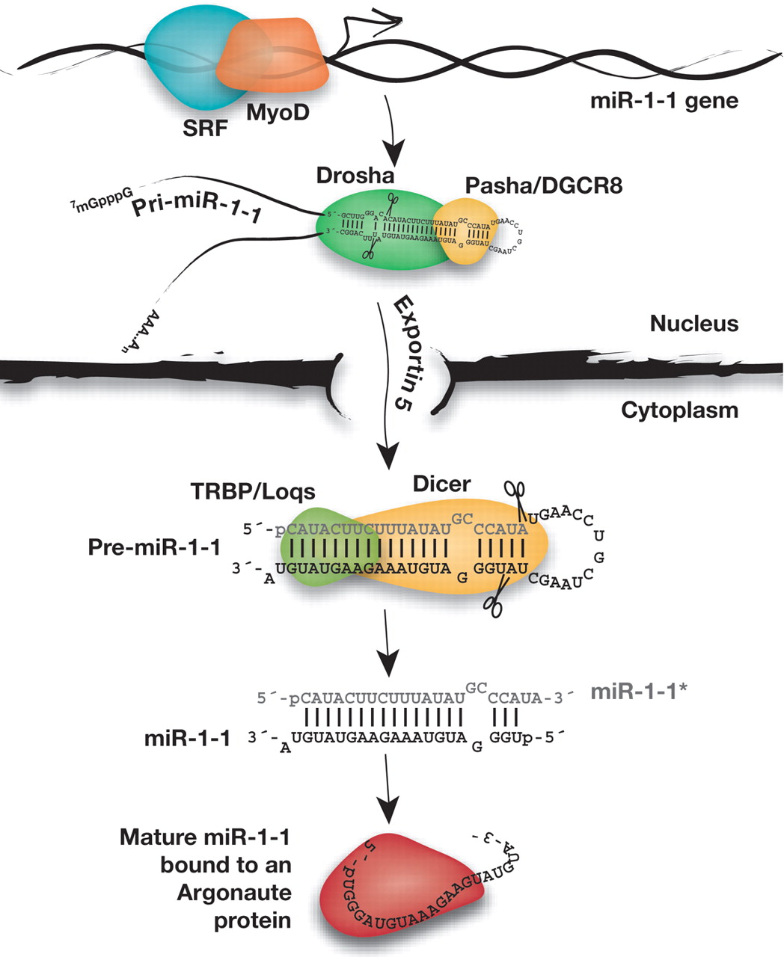
A day in the life of the miRNA miR-1
Zamore et al.: Ribo-gnome:the Big World of small RNAs, Science 2005;309:1519-1524

Slide 39
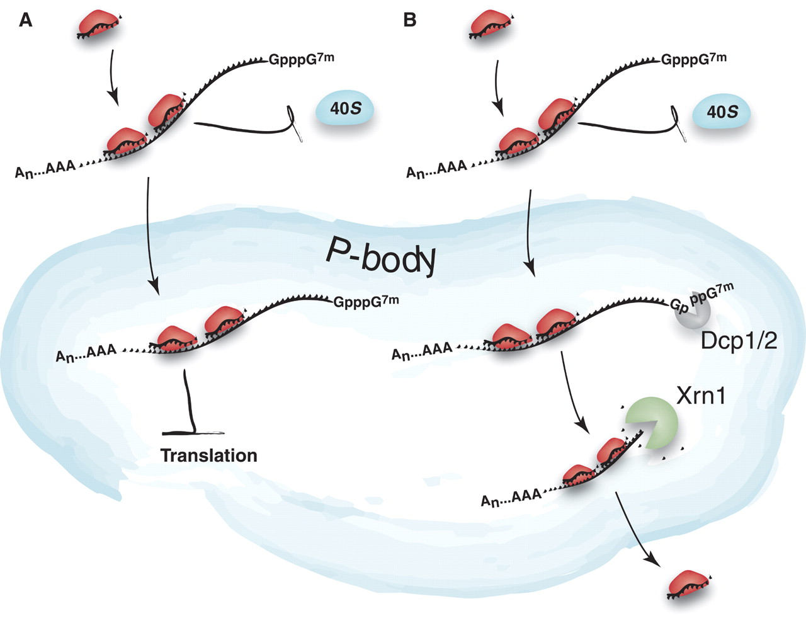
A model for translational repression by small RNAs: sequestration of a highly stable mRNA in the P-body
Zamore et al. Ribo-gnome:the Big World of small RNAs, Science 2005;309:1519-1524

Slide 40
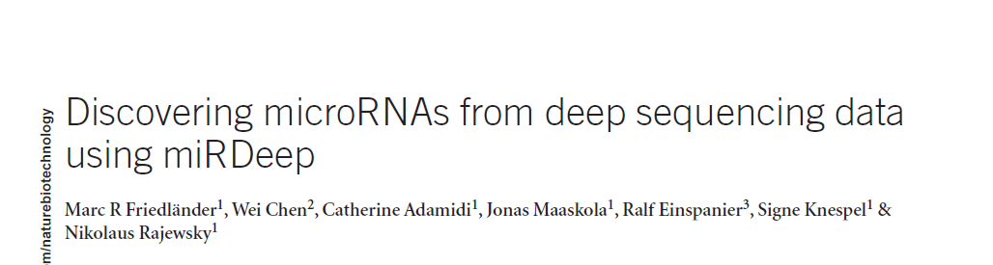
PMID: 18392026
PMID: 23958307

Slide 41
Research in RNA Bioinformatics past and perspectives -I
Initially focus on folding of single RNA molecules, but further improvements:
  Nussinov algorithm
  Zuker algorithm and partition function
  Fold many sequence togehter -> exploiting comparative information
  More complex models for finding RNA motifs
  Functional motifs /3D folding instead of only secondary structure
Searching for ncRNAs
miRNA identification – valid methods
lncRNA (~13000 in the human genome) new challenge: poorly annotated, poorly conserved, strucures unkown
Focus RNA-RNA interactions and RNA-protein interactions
  miRNA target prediction
  lncRNA target prediction (indirect methods)
  RNA Binding Proteins (RBPs)

Slide 42
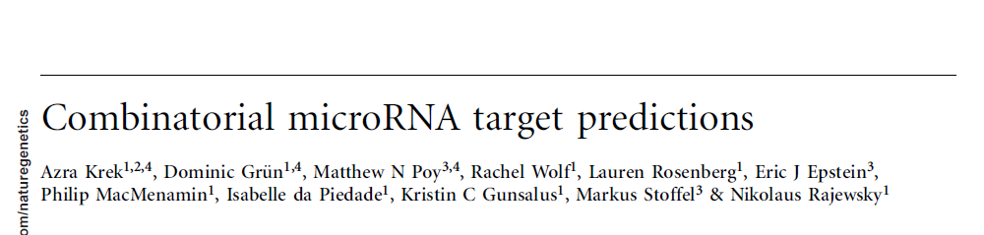
miRNA-mRNA target sites
PMID: 20799968
PMID: 15806104

Slide 43
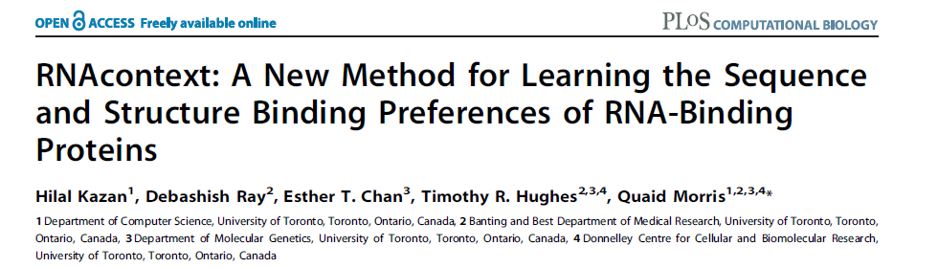
RNA-protein binding sites
PMID: 20617199
PMID: 24398258

Slide 44
Conclusion & Future
RNA bioinformatics in rapid growth
RNA-seq data are changing the scenario towards data-driven approaches as preferrable to pure algorithmic approaches -> different lincRNA isoforms, primiRNA transcripts, ncRNA detection
Area in development: Using genomic variants (SNPs) to:
  Model ncRNA regulation at transcriptional level
  Find associations lncRNA-genes
  Impact of SNPs on secondary structure
Promising: chromatin conformation data (HiC, CHIA-PET)
  Network-based methods (clustering) to discover ‚ehnancer‘ lincRNA
The RNA Bioinformatics group
www.molgen.mpg.de/2733742/RNA-Bioinformatics

Slide 45
Appendix A - Nussinov Algorithm
Structure can be folded recursively -> dynamic programming
x1…….xN sequence of N nucleotides to be folded. Compute maximum number of base pairs formed
by subsequence x[i:j] assuming we already computed for all short sequences x[m:n] i<m<l<j
Structure on x[i:j] can be computed in several ways:
1)
2)
3)
4)
bifurcation
Notes:
We can obtain a structure x [i:j] in different ways: by considering the structure on x[i+1:j] (or x[i,j-1]) and adding an unpaired base at position i (or j). This does not change the number of base pairs in the structure. Alternatively, if nucleotides at positions i and j can pair then a structure is obtained enclosing x [i+1,j-1] with a new base pair (i,j). This increases the number of base pairs. There is only one further alternative: if i and /or j are paired but not with each other, then our structure must consist of two substructures, i.e. There must be a k i<k<j such that our structure can be split into a substructure on x[i:k] and another substructure x[k+1,j].

Slide 46
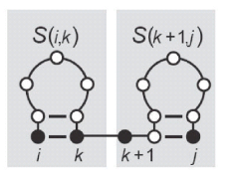
Nussinov Algorithm
i
1)
j-1
j
i
i+1
j
2)
Graphical
represenation of
the folding algorithm
=
i
j
3)
i
i+1
j-1
j
i
4)
k
k+1
j
1) i is unpaired
2) j is unpaired
3) i,j paired
4) bifurcation
Notes:
Here the recursive decomposition of structures is illustrated. An isolated bullet refers to an unpaired nucleotide and a straight line with bullets at the end to a subsequence with arbitrary structure. Arcs represent base pairs.
This graphical representaion can be converted into a recursion to fill a matrix S(i,j), the DP matrix, where each cell contains the maximum number of base pairs on the sequence x[i:j].

Slide 47
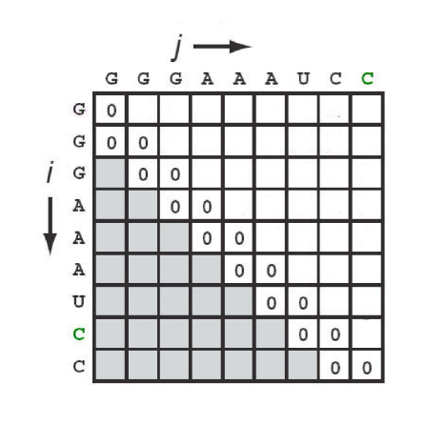
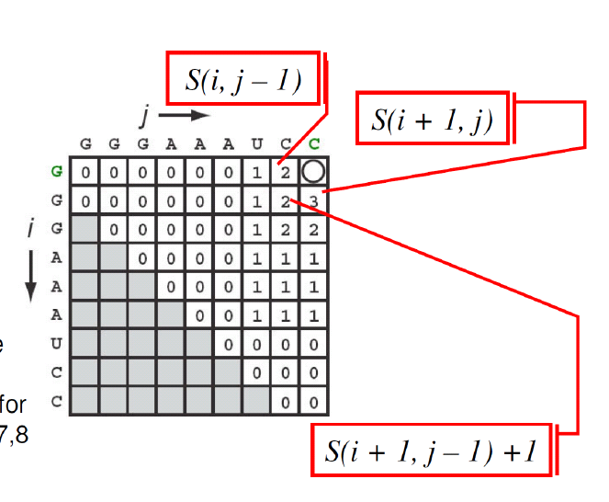
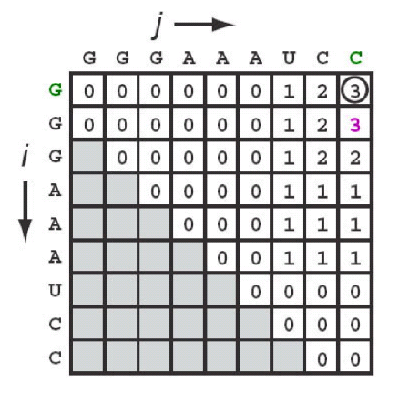
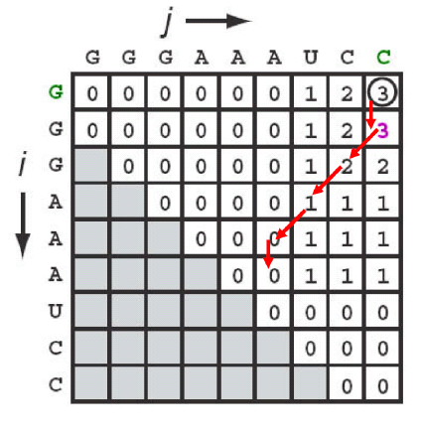
Nussinov Algorithm - example
A Initialization
B Fill in upper part of the matrix i=1…N.
Termination S_{1,N}=max number of base pairs
C Get final score after
considering bifurcations
D Backtracking and construction
of secondary structure
Notes:
If you have a matrix, each cell above the diagonal represents a subsequence from i to j and it contains the maximum number of base pairs.The maximum number of pairs for the whole sequence will be the upper right cell -> we will fill in the upper part of the matrix.
This tecnique of recursively computing and tabulating is commonly referred to as dynamic programming. The recursion is summarized in the formula on the upper left corner. The recursion counts the number of base pairs for any subsequence until the whole sequence from 1 to N has been reached. The structrure itself is obtained by backtracking. In detail: if i & j form a base pair, add i and j onto the best structure found for subsequence i+1 and j-1 and increment the score in the cell by one. If i is unpaired, add the unpaired position i onto the best structure for subsequence i+1, j and do not increment the score. If j is unpaired add the unaired position j onto the best structure for subsquence i, j-1. In case of a bifurcation combine the optimal substructures and choose the k value that minimizes the sum of the socres from these substructures.
If we look at the example in the slide, subsequences of length 1 and 2 get a score of zero (initialization). This is equivalent to require a minimum loop length of two. The next step is to fill the matrix. Afterwards we have to consider bifurcations for k=2,3,4,5,6,7,8 and finally get the final score. To retrieve the structure itself we have to perform backtracking (Figure D). Note that there can be several paths in the matrix, i.e. several structures, corresponding to the same final score.

Slide 48



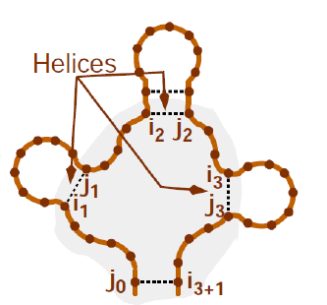
Appendix B – Zuker algorithm
Energy of secondary structure elements
If E_{i,j}^{P} = energy of structural element (i,j). P set of base pairs for each element
Complete energy
Hairpin loop (i,j)
eH(i,j)
Stacking (i,j)
eS(i,j,i+1,j+1)
Internal loop (i,j,i‘,j‘)
eL(i,j,i‘,j‘)
K-multiloop
eM(j₀,i₁,j₁, ….i_{k},j_{k},i_{k+1})
calculaiton done for all
possible multiloops
Notes:
Prediction of RNA structure using thermodynamcs. Stability numbers are assigned to the predicted structures according to melting temperature and other experimental thermodynamic data.
For loop-decomposition energy models the same principle of dynamic programming applies. We build the optimal solution of larger problems from the optmal solution of smaller subproblems. We perform a loop decomposition and for each base pair i,j we have to distinguish which type of loop is closed by the base pair.
Let‘s now define the energy contribution of different motifs:
- A hairpin loop consists of i and j pair which encloses unpaired nucleotides. This will have a certain energy asspciated which we call eH(i,j).
- A base pair i,j is called ‚stacking‘ if the previous base pair was also a canonical base pair (a hairpin stem is formed by severla stacking). A stacking is associated to a stacking energy which we will call eS(i,j,i+1,j+1)
- An internal loop is formed by two base pairs (i,j) and (i‘,j‘) which enclose pairs which are not stacking (includes also right and left buldges).
- A k-multiloop consists of several base pairs and each of these base pairs encloses a smaller loop (or a loop+stacking). Such smaller stacking+loop elements are called ‚helices of the multi-loop‘.
The energy for the multiloops has to be computed for all posible k-loops. This results in an exponential explotion of the calculation. Therefore, the enery of a multi-loop eM has usually a simplified (linear) form eM = a+bk+ck‘, where k = number of helices, k‘ = numer of unpaired basis within the loop a,b,c,are weights. In particular, a is the contribution for closing the loop

Slide 49
Zuker algorithm-predicting RNA structure using thermodynamics
S RNA molecule of length N; i and j two nucleotides from S with 1≤ i ≤ j ≤ N
For all pairs of i,j 1≤ i ≤ j ≤ N let W(i,j) be the minimum free energy for all structures formed by susequence S_{i,j}
V_{(i,j)}minimum free energy of all possible structures formed by S_{i,j} in which i and j are paired with each other
WM_{(i,j)}minimum free energy of all possible structures formed by S_{i,j} which are part of a multi loop
Notes:
W(i,j) and V(i,j) are computed recursively.

Slide 50

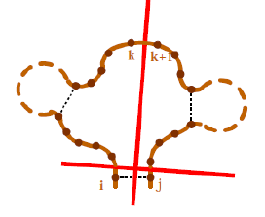
Zuker: loop decomposition, compute V(i,j)
Hairpin loop
Case 1
Stack
Case 2
Internal loop
Penalty for forming a multiloop
+
+
a
+
+
a
Case 3
Notes:
Computation of V(i,j) . If i and j cannot base pair, then V(i,j)=∞
Remember that V(i,j) is the minimum energy of a structure formed by i and j where i and j are base-paired. A base pair i,j, can enclose different types of structures (described in previous slides). Therefore V(i,j,) can be computed in 4 possible ways.
Heuristically, the algorithm works by adding a nucleotide at a time to the sequence and observing what the best structure is at each step
In the last case the energy is split into the sum of the energies of the two substructures.
Translated into the dynamic programming formula: V(i,j) is the minimum of the energy that cna be obtained in three ways (see following slide)

Slide 51
Zuker: loop decomposition, compute V(i,j)
Summarizing V(i,j) is the minimum free energy that can be obtained in three ways:
V(i,j) = min { E₁, E₂, E₃ }

Slide 52
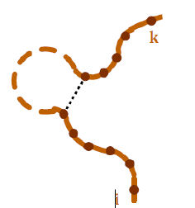
Zuker: multiloop handling, compute MW(i,j)
No basepairing
between i and j. Keep
decomposing the loop
+
One dangling end (i.e. unpaired nucleotides)
+
c
Penalty for unpaired nucleotides
+
b
i and j for a base pair
Penalty for ‚closed‘
structure in multiloop
Notes:
Now imagine a structure S_{i,j} with energy W(i,j), optimal free energy for a substructure that is part of a multiloop.
Again, there are three possibilities:
1) if no base pair between i and j then keep decomposing the loop
2) one dangling end (either i or j)
3) i and j form a base pair (we are in the previous case, the energy is V(i,j))

Slide 53
Zuker: multiloop handling, compute MW(i,j)
WM(i,j) -> S_{i}, ...S_{j} is part of a multiloop (i,j no basepairing!)
multiloop must be split at least once, otherwise simple internal loop
Idea: cut parts of multiloop until only single helices are left

Slide 54
MFE-loop decomposition
First proposed by Zuker (previous slides)
Slightly different implementation in RNAfold (Vienna package)
DP apporach, 4 matrices used to score
    the whole structure (F)
    substructure with closing loop (C)
    multi-loops (M), (M‘)
M and M‘ used to decompose multi-loop „form the right“

Slide 55
MFE-loop decomposition
M‘ is the optimal free energy of a substructure in a multiloop with a closed structure
Followed by zero or more unpaired bases
Notes:
RNalifold introduces an additional matrix M‘

Slide 56
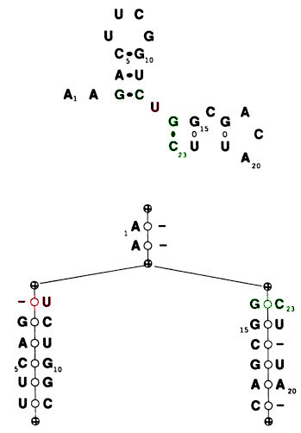
Appendix C - Tree represenation of an RNA structure
Nodes represent
  Base pair if two bases are shown
  Loop if base and “gap” (dash) are shown
Pseudoknots still not be represented
Tree does not permit varying sequences
  Mismatches
  Insertions & Deletions

